Slide 1




SEND Information Report
September 2026
Reporting on academic year 2025-2026
As of September 2026- we have been rebranded as:

Slide 2

Publication Date: September 2026
Review Date: September 2027
At Howard Junior School we believe in participation and achievement for all. We aim to create an inclusive culture in our school and respond positively to the diversity of the children’s backgrounds, interests, experience, knowledge and skills so that all pupils, regardless of individual need, make the best possible progress.
This SEND Information Report describes the range of provision and support available to support identified children as and when appropriate. This is subject to change depending on budgetary constraints and policy review.

Slide 3
This report details our annual offer to learners with SEND.
To be effective, it needs the views of all: parents/carers, pupils, governors and staff.
If you have any comments, please contact:
Mr Ben Paull (Principal)
Mrs Sophie Hopkins (SENDCo) Special Educational Needs Co-Ordinator or
Mrs Kath Hodgson (Governor)
Contact details: 01553 774511
Email: office@hjs.eastern-mat.co.uk
Approved by: Date: September 2026
Last reviewed: September 2026 Next review due by: September 2027

Slide 4
SEND Information Report Contents
5 | Our SEND profile for 2025-2026 | 23 | Q. What additional support for learning is available to pupils with special educational needs and/or disabilities?
8 | Q. How is SEND defined by the Department of Education? | 24 | Q. How will my child be involved in decisions regarding provision that can better meet his/her needs?
9 | Q. How does the school know if my child needs extra help? | 25 | Q. How will I be helped to support my child’s learning? Q. How will I be involved in discussions about and planning for my child’s education?
11 | Q. What are the kinds of special educational needs do we make provision for at Howard Junior School? | 26 | Q. How will the school prepare/support my child when joining the school or transferring to a new school?
12 | Q. How do we assess and review children’s progress? | 28 | Q. How will my child be included in activities outside the classroom, including school trips?
15 | Q. What specialist services are available at Howard Junior School? | 29 | Q. How accessible is the academy’s environment?
16 | Q. How will the school support a child with SEND? | 30 | Q. What support is there for children’s overall well-being?
19 | Q. How will the curriculum be matched to each child’s needs? | 31 | Complaints Procedure
20 | Q. How are the school’s resources allocated and matched to children’s special educational needs? | 33 | Helpful links
22 | Q. How are the staff at Howard Junior School supported to work with children with SEND and what training do they have?

Slide 5
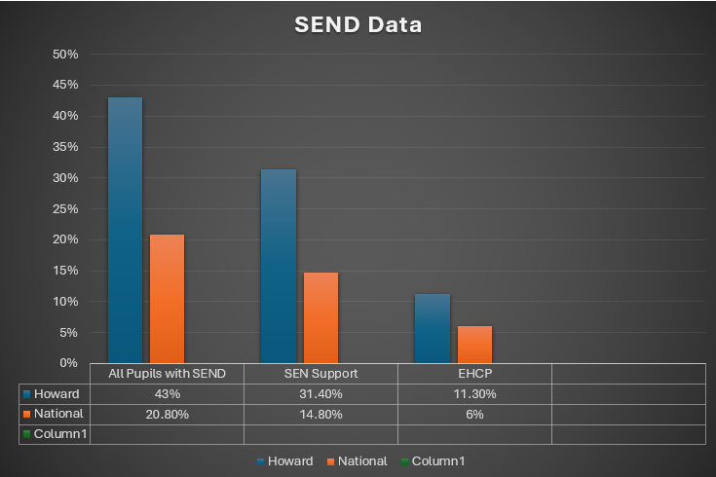
Our SEND profile for 2025-2026
Our school SEND profile compared with National Data (June 2026).
Notes:
Add your own data here

Slide 6
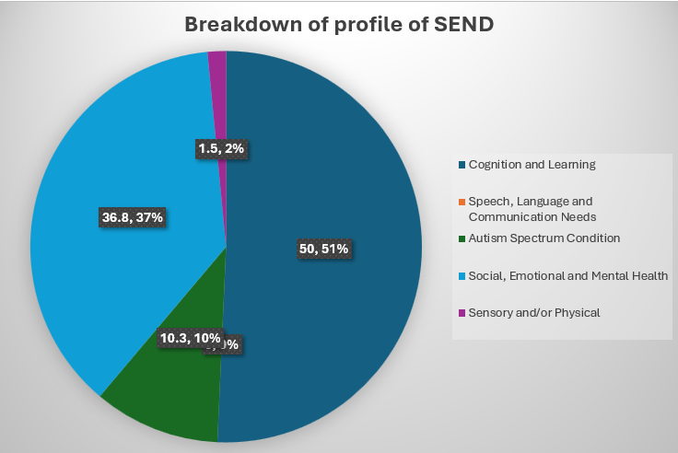
Our SEND profile for 2025-2026
43% of children at Howard Junior School have a primary identified area of need; the breakdown is shown here.
Notes:
Replace with your school data

Slide 7
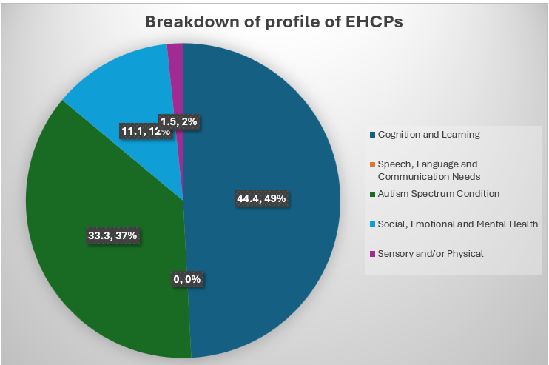
Our SEND profile for 2025-2026
11.3% of children at Howard Junior School have an EHCP – the breakdown of their primary identified need is shown here.
Notes:
Replace with your school data

Slide 8
Q. How is SEND defined by the Department of Education?
At different times in their school career, a child or young person may have a special educational need.
The Special Educational Needs Code of Practice (2014) defines SEND as:
The Code of Practice 2014 defines SEN as follows:
“A child or young person has SEN if they have a learning difficulty or a disability which calls for special education provision to be made for him or her. A child of compulsory school age or a young person has a learning difficulty if he or she:
has a significantly greater difficulty in learning than the majority of others the same age, or
has a disability which prevents or hinders him or her from making use of facilities of a kind generally provided for others of the same age in mainstream schools or mainstream post-16s institutions.”
SEND code of practice: 0 to 25 years - GOV.UK

Slide 9
Q. How does the school know if my child needs extra help?
Where a pupil’s progress is significantly slower than that of their peers, or fails to match their previous rate of progress, despite high quality first teaching targeted at specific areas of difficulty, it may be that the child has SEND. Information will be gathered, including seeking the views of parents and the pupil, as well as from teachers and assessments.
There can be many reasons for learners ‘falling behind.’ These may include absences, attending lots of different schools, or worries that distract them from learning. Children who experience such barriers to learning are vulnerable, but this does not mean that all vulnerable learners have SEND. Only those with a learning difficulty that requires special educational provision ‘additional to’ or ‘different from’ the usual differentiated curriculum will be identified as having SEND.
If a learner is identified as having SEND, we will provide provision that is ‘additional to or different from’ with the intent of overcoming their barriers to their learning. We follow the SEND Code of Practice Graduated Approach/Response, so-called as it may take several cycles of intervention and different strategies being tried before support needs are understood and met. It involves regular meetings with the child and parent to monitor, assess and review progress and outcomes.

Slide 10
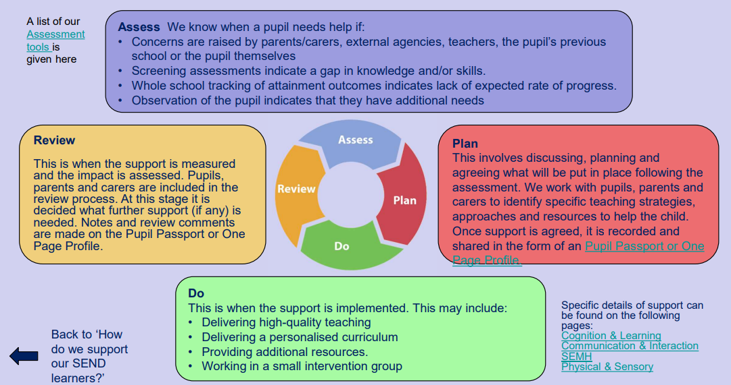
The Graduated Response: Assess, Plan, Do Review cycle
Monitoring progress is an integral part of teaching and leadership at Howard Junior School. We follow the ‘Assess, Plan, Do, Review’ model using Provision Map and ensure that parents/carers and children are involved in the process.

Slide 11

Q. What are the kinds of special educational needs we make
provision for at Howard Junior School?
Cognition and Learning
Children might:
• Learn at a slower pace
• Find the curriculum difficult
• Struggle with organisation and memory • Have a specific difficulty in literacy or numeracy e.g. Dyslexia, Dyscalculia, Dyspraxia
Sensory and/or Physical
Children might have a:
• Vision impairment
• Hearing impairment
• Multi-sensory impairment
• Motor skill difficulties • Physical disability
Sensory Processing e.g. noise
Social, Emotional & Mental Health
Difficulties
Children might:
• Find relationships difficult, appear withdrawn or isolated
• Behave in ways that affect their learning
• Have underlying mental health difficulties such as anxiety, depression, self-harming, eating disorders
• Have disorders e.g. ADD, ADHD, Attachment Disorder
Communication and Interaction
Children might:
• Struggle to talk or say what they want to
• Find it hard to understand what others are saying
• Find conversations and play confusing and challenging
• Have a diagnosis of Autism Spectrum Disorder (ASD)
Some pupils may have needs that covers more than one of these areas.

Slide 12

Q. How do we assess and review children’s progress?
Children, parents/carers, teaching and support staff are directly involved in the review progress. This review takes the form of a formal meeting held at least once a term, where the SEN Support targets can be reviewed and progress and next steps can be discussed. If a learner has an Education Health and Care Plan (EHCP), the same termly review conversations take place, as well as an annual formal review of the EHCP.
The school senior leaders track the attainment and progress of all children in Year 3 to Year 6, including those with special educational needs, through a termly pupil progress meeting with the class teacher. Areas for concern are identified and fed back to class teachers for action. The results are also analysed by the class teacher and used to inform the ‘assess, plan, do, review’ cycle.
The school SENDCo collates the impact data from targeted interventions. Progress data for all learners is collated half termly in pupil progress meetings and is monitored by Teachers, Senior Leaders and Governors. Adaptations to interventions and additional support are made following the review of this data.
Data from assessments is compared against historic school data, in addition to comparisons with National statistics

Slide 13

Education Health Care Plans
For a very small percentage of pupils whose needs are significant and complex, a request will be made to the local authority to conduct an assessment of their education, health and care needs. This may result in an Education, Health and Care (EHC) plan being provided. Where a child has an EHCP, there will be an annual review held in addition to the termly review meetings, taking into account the views of the child, their parent or carer, and all other professionals involved with the child. These pupils will receive additional provision to support their needs. The school will outline additional support and provision on a costed provision map which is submitted to the Local Authority as part of the process for allocating funding to support pupils with SEND in the school. Further information about Norfolk EHCPs can be found here:
Education, health and care (EHC) plans - Norfolk County Council
School budget share - Norfolk Schools and Learning Providers - Norfolk County Council

Slide 14

The following assessments are used across our school to identify SEND needs.
Cognition and Learning:
Little Wandle Phonics assessments
Salford – Sentence reading
Dyslexia Portfolio – literacy screening
Reading speeds
Sandwell Early Numeracy Assessment – EYFS/KS1 and KS2
PIXL Assessment
Sensory and/or Physical
Fine motor skills checklists
Gross motor skills checklists
Sensory Profile checklist
Social Emotional and Mental Health
Boxall Profile
Strengths and Difficulties Questionnaire
Self-Esteem Indicator
SNAP IV – Attention and concentration
Checklists
Communication and Interaction:
WELLCOMM – primary toolkit for speech and language
Renfrew Word Finding Test – vocabulary skills
Blank Levels – understanding of language
Checklists

Slide 15




Education Services | Virtual Academy SEND Virtual Academy Sensory Support Virtual Academy Looked After Children Educational Psychology Specialist Support LA Inclusion Team LA SEND Team LA Zones Team Schools and Communities Team
Health Services | Just One Norfolk, Just One Number – 0300 300 0123 Speech and Language Therapy Service Occupational Therapy Children and Adolescent Mental Health Services (CAMHS)
Social Care Services | Short Breaks Early Help Hubs Early Childhood and Family Service (ECFS) Family Support process (FSP)
Third sector services | Carers matter Nelson’s Journey Young carers
Q. What specialist services are available at Howard Junior School?

Slide 16

Q. How will the school support a child with SEND?
At Howard Junior School, every teacher is a teacher of SEND pupils and is required to adapt the curriculum to meet the needs of the children in his/her class in line with the expectations set out in The Teacher Standards (2012).
All pupils will be provided with high quality teaching that is adapted to meet the needs of all learners. The quality of classroom teaching provided to pupils with SEND is monitored through processes that include:
Classroom observation by the Senior Leadership Team/Trust Lead SENCo/school SENCo
Ongoing assessment of progress made by pupils with SEND
Work sampling and scrutiny of planning to ensure effective matching of work to pupil need
Teacher meetings with the SENCo to provide advice and guidance on meeting the needs of pupils with SEND
Pupil and parent feedback on the quality and effectiveness of interventions provided
Attendance and behaviour records.

Slide 17
Q. How will the school support a child with SEND?
Staff receive training and support to ensure that they provide quality first teaching. They also identify and deliver short term support interventions alongside other support staff where appropriate. Individualised support and interventions for the higher need pupils are implemented by support staff under the guidance of the class teachers, SENDCo and school Principal. All interventions are monitored for impact with assessments at the beginning and the end of each block of support.
All pupils with SEND have individual targets relating to their areas of need. Parents/ carers are informed of these via the Support Plan review process and at Parent/carer consultation sessions.
Pupils with a disability will be provided with reasonable adjustments to overcome any disadvantage experienced in the school and increase their access to the taught curriculum.

Slide 18

Q. How will the school support a child with SEND?
Additional support and intervention is outlined on the child’s support plan so that all staff are aware of their needs. Examples of our provision include (but is not limited to):
adapting learning tasks
using visuals to support literacy difficulties
using manipulatives such as Numicon, cubes, counters, bead strings
using technology to record ideas and knowledge to ensure children’s difficulties with written work do not impact unnecessarily on all areas of the curriculum
use of visual timetables
movement breaks
adults used to scribe ideas
use of speech to text technology
ear defenders

Slide 19
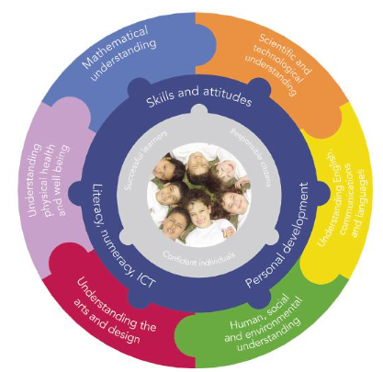
Q. How will the curriculum be matched to each child’s needs?
Teachers plan using pupil achievement levels, adapting tasks to ensure progress for every pupil in the classroom.
Where appropriate, the learning environment will be further adapted by the class teacher to reduce barriers to learning and enable the child to access the curriculum more easily.
These adaptations may include strategies suggested by the Special Educational Needs Coordinator (SENCo) and/or external specialists.
In addition, pupils may be provided with specialised equipment or resources such as ICT (e.g. SEND specific software, iPads) and/or additional adult help. All actions taken by the class teacher will be recorded and shared with parents.
Some learners in KS2 who are significantly below age related expectations will have access to bespoke Maths and English offer within our Aspire Suite.
The physical environment has been adapted to support children with medical needs (see Accessibility Plan).

Slide 20
The Aspire Suite
For a very small number of pupils, accessing a mainstream classroom may be too overwhelming for them on a full-time basis. These pupils will have an EHCP or an application in progress. The Aspire Suite has been developed as a provision to support these pupils. The pupils follow a bespoke curriculum adapted to their developmental needs whilst still following the national curriculum. 1:1 interventions are in place to support the section F outcomes identified in each pupils’ EHCP.
There are a maximum of 8 pupils in a group at any one time, supported by 2 adults. The pupils have opportunities for working with their year group peers as appropriate e.g. PE and Art. The Aspire Suite is managed by Mrs Hopkins, our SENCo. For more information, please use this link:

Slide 21
Q. How are the school’s resources allocated and matched to children’s special educational needs?
The school receives funding to support pupils with SEND from a number of sources:
A proportion of the funds allocated per pupil to the school to provide for their education called the Age Weighted Pupil Unit.
The Notional SEN budgets. This is a fund devolved to schools to support them to meet the needs of pupils with SEND.
For those pupils with the most complex needs, the school may be allocated additional educational needs funding from the Local Authority’s High Needs SEN Funding allocation.
SEND Allocation link
Notes:
Please use this link to find your SEND budget Memo (Norfolk academies only) Childrens Services ICT Solutions

Slide 22
Interventions and resources used to support the four areas of need include:
Communication and Interaction | Cognition and Learning
Speech and Language support- assess/plan/do/review cycle 1:1 speech therapist provided by NHS SALT and/or a specialist Interventions/small group sessions designed to target identified areas of need. Interventions/small group sessions designed to target identified areas of need. Input from external agencies Now/Next or First/Then Boards Social Stories | 1:1 and /or small group intervention Word building and high frequency word recognition interventions using Precision Teaching techniques Little Wandle Phonics assessed into Phase Groups Concrete maths materials in class Small group Maths Interventions In -class support from TA where appropriate/possible. Access to Literacy Gold Reasonable adjustments appropriate to the child
Social, emotional and mental health | Physical and sensory
Mental Health Support Team referrals and input within school for staff training Benjamin Foundation- Time for You sessions Staff CPD Staff identify children with mental health problems and discuss with SENCo or DSL for intervention | Interventions for Fine Motor Skills and Gross Motor Skills. Additional handwriting practice Coloured paper Individual support in class during PE and lunch time where necessary Advice sought from specialists such as Occupational Therapists Large print resources/ text
Please see our full offer here

Slide 23
Q. How are staff at Howard Junior School supported to work with children with SEND and what training do they have?
Every teacher is a considered to be a teacher of SEND and is supported in their role by the SENDCo, who:
Ensures that all members of staff in the school have a clear understanding of each child's Special Educational Need and/or Disability and aids them in their practice.
Provides all staff with training on the SEND needs in the school and training relating to specific children.
Updates the teaching staff in staff meetings about recent government initiatives within the SEND system and relays back information gathered from SEN conferences and courses.
Training to support Communication and Interaction needs | Training to support Cognition and Learning needs | Training to support Social, Emotional and Mental Health needs | Training to support Physical and or Sensory needs
Speech and Language training Autism Training EAL Training | Phonics training Adaptive teaching TA Networks | Mental Health Champion Mental Health First Aid Norfolk Steps – Step Up and Step On | Paediatric First Aid Diabetes training EpiPen training Sensory Circuits training Epilepsy training Specific medication training

Slide 24

Q. What additional support for learning is available to pupils with
special educational need and/or disabilities?
Pupils with English as an additional Language (EAL) and SEN
All children with English as an Additional Language in the school are supported through visuals, peer buddies and signing, to access learning and we carry out specific language intervention as appropriate. All areas of development are carefully considered and discussions with parents through an interpreter or translation service may take place to establish if the delay in learning is attributed to their command of English or to an emerging SEND need.

Slide 25

Q. How will my child be involved in decisions regarding
Provision that can better meet his/her needs?
SEN Support Plans (SSPs)
Our school listens to pupils, where appropriate, when creating their SEN Support plans. Pupil views are collected with support from a familiar member of staff. These are reviewed with the child each term.
The views of pupils with an EHCP are sought prior to annual reviews. Where appropriate, pupils are invited to attend the meeting.
Pupil Leadership Team
Each house has a representative year 6 pupil who attends leadership meetings and supports day-to-day life in school. Children know who they are and who they can speak to.
Pupil Voice
Our school completes pupil voice questionnaires throughout the year. Class circles take place in each class; discussions can be general or focus on something specific.

Slide 26

Q. How will I be helped to support my child’s learning?
Q. How will I be involved in discussions about and planning for my child’s education?
At Howard Junior School:
You will be invited to come and talk openly with the class teacher and/or SENCo to establish where the need lies and the support you may need.
You will work in partnership with staff to support targets, and to keep the school informed of developments and advice that you get from other services.
Your child’s class teachers will meet formally with you at least three times each year and an annual report is prepared and shared with you in the Summer Term.
Where your child holds an EHCP, a formal review will take place annually from the date of the previous review, or sooner if needed. You are asked for your views as is your child throughout this process.
Howard Junior School operates an open-door policy.
If you have any concerns regarding your child’s progress or well-being, then please speak to your child’s class teacher or Mrs Hopkins (SENDCo).

Slide 27

Q. How will the school prepare/support my child when joining or transferring to a new school?
A planned introduction programme is delivered in the Summer term to support transfer for pupils starting at Howard Junior School in September. Parent/carers and children are invited to visit the school to look around.
A Welcome to Year 3 meeting is also held in that Summer Term where the Year 3 team, school Principal and SENDCo will give you additional information and will be available to talk to you.
Where necessary, the SENDCo and class teachers will arrange a further meeting with parents and other professionals who are supporting the child
If pupils are transferring from another setting, the previous school’s records will be requested immediately and a meeting set up with parents to identify and reduce any concerns.

Slide 28
Preparing for next steps
Transition is a part of life for all learners, whether that involves moving to a new class or moving to a new school. We recognise that transition is an important time for all children, but especially so for a child with SEN. We work closely with parents, pupils and staff to ensure these transitions run as smoothly as possible.
When moving to a new class within the school, we provide:
Transition Day, where children are able to spend time with their new classmates and teachers
Staff handover meetings
When moving to a new school at the end of Year 6, we provide:
Opportunities for targeted transition work
Opportunities for pupils and parents to meet staff in the new school.
Accompanied visits to other providers, as appropriate.
For pupils transferring to local academies, the SENDCos of both academies will be in contact to discuss the needs of pupils with SEN in order to ensure a smooth transition.
The records of pupils who leave the school mid-year will be transferred within five working days of the parents notifying us that their child has been enrolled at another school.

Slide 29


Q. How will my child be included in activities outside the
classroom including school trips?
Class Trips and clubs
At Howard Junior School, we believe all learners are entitled to access to extra-curricular activities. We are committed to make reasonable adjustments to ensure participation for all. Risk assessments are carried out and procedures are put in place to enable all children to take part in all school activities. Any additional support or necessary adjustments are recorded on the risk assessment for that activity. The school ensures it has sufficient staff expertise to ensure that no child with SEND is excluded from any school provided activity.

Slide 30

Q. How accessible is the school environment?
The school is fully compliant with DDA (Disability Discrimination Act) requirements.
The school has an up-to-date accessibility plan which is reviewed each year and whenever there is building work. Our Accessibility Plan describes the actions the school has taken to increase access to the environment, the curriculum and to printed information and is available on the school website (Policies and Documents)
In addition:
We have reorganised class bases to accommodate the specific needs of pupils.
Ramps are in place to aid accessibility
We ensure, wherever possible, that the equipment used is accessible to all children regardless of their needs.
After-school provision is accessible to all children, including those with SEND.
For pupils with English as an additional language, we are able to access support from the Local Authority EAL Team
Extra-curricular activities are accessible for children with SEND.
The school has an outside learning area (Forest School)

Slide 31

Q. What support is there for children’s overall well-being?
The well-being of pupils at Howard Junior School is a priority.
The Mental Health Champion organises pastoral care. Staff support pupils to ensure that those who require pastoral support can access that support at the time it is needed. A variety of pastoral interventions are available.
The school have additional support through a Time for You worker from the Benjamin Foundation.
Where there is a medical need, staff work closely with health professionals to ensure these needs are met.
For some children with a medical need, a Health Care Plan will be created so that there is a clear protocol that provides accurate information regarding the correct medical care for the child.
Prescribed medication can be administered if the school is in receipt of a signed medication administration permission form from parents.

Slide 32
Complaints Procedure
If you are not happy with the provision made available to your child, you can:
Talk to your child’s class teacher
Discuss your concerns with the Special Educational Needs Co-ordinator
Get free confidential and impartial information, advice and support from:
Norfolk SENDIASS (Special Educational Needs and Disabilities Support Service) This service provides free, confidential and impartial information, advice and support about SEND for children, young people, parents and carers.
T 01603 704040
W: https://www.norfolksendiass.org.uk/
KIDS dispute resolution service
T: 03330 062835
E: senmediation@kids.org.uk
W: www.kids.org.uk
The Eastern Multi Academy Trust’s Complaint Policy can be found on our website.

Slide 33

Links to important documents
SEND Policy
Equality Information
Complaints Procedure
Medical Needs Policy
Behaviour Policy
Safeguarding Policy
Accessibility Plan
Admission Arrangements

Slide 34

Other Useful Links
Norfolk Local Offer for SEND – www.norfolk.gov.uk/send
Here you will find information about provision that is available, and expected provision, across: Education, Health and Social care for children and young people who have special educational needs and disabilities (SEND).
Just One Norfolk - Health Advice & Support for Children & Families
Norfolk SEND Partnership: www.norfolkparentpartnership.org.uk
National SEND Code of Practice: www.gov.uk/government/publications/send-code-of-practice-0-to-25
You will find more links on our website.

